Slide 1
Neural Network

Slide 2
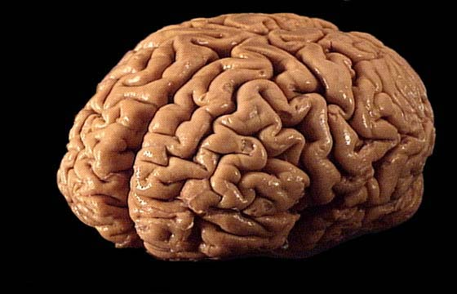
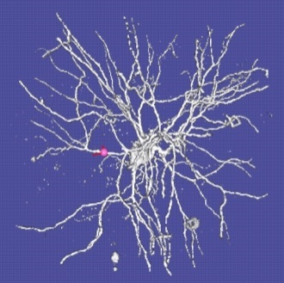
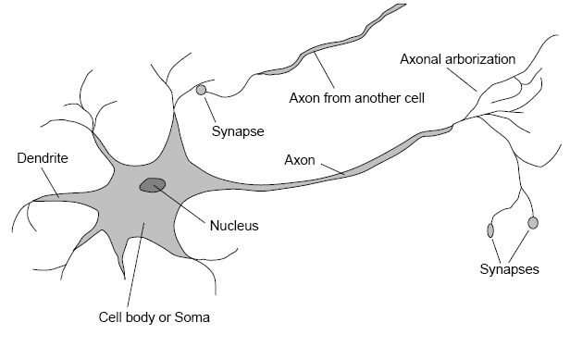
Neural Networks
Computational model inspired by the brain
based on the interaction of
multiple connected processing elements
(Connectionism, parallel distributed processing, neural computation)
.
Brain
When inputs reach some threshold
→ an action potential
(electric pulse)
is sent along
the axon to the outputs
Inputs
Outputs
Brain made up
of neurons (~10¹¹)
Brain’s information and processing power
emerges from a
highly interconnected
network of neurons.
Connection between cells
Excitatory or inhibitory
and may change over time
Around 10¹¹ neurons, 10¹⁴ synapses; a cycle time of 1ms-10 ms.

Slide 3
Neural Networks
The brain is made up of neurons which have
Dendrite — It receives signals from other neurons.
Soma (cell body) — It sums all the incoming signals to generate input.
Axon — When the sum reaches a threshold value, neuron fires and the signal travels down the axon to the other neurons.
Synapses — The point of interconnection of one neuron with other neurons. The amount of signal transmitted depend upon the strength (synaptic weights) of the connections.
The connections can be inhibitory (decreasing strength) or excitatory (increasing strength) in nature.
So, neural network, in general, is a highly interconnected network of billions of neuron with trillion of interconnections between them.

Slide 4
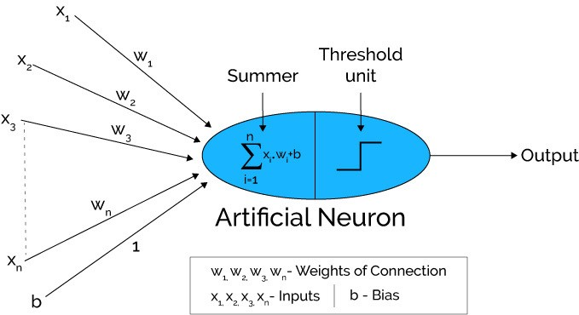
Artificial Neural Networks
Artificial neural networks can be viewed as weighted directed graphs in which artificial neurons are nodes and directed edges with weights are connections between neuron outputs and neuron inputs.

Slide 5
Connectionist Models of Learning
Characterized by:
A large number of very simple neuron-like processing elements.
A large number of weighted connections between the elements.
Highly parallel, distributed control.
An emphasis on learning internal representations automatically.
But of course the interconnectivity is not really at the brain scale…

Slide 6
Neural networks learn from examples
No requirement of an explicit description of the problem.
No need for a programmer.
The neural computer adapts itself during a training period, based on examples of similar problems even without a desired solution to each problem. After sufficient training the neural computer is able to relate the problem data to the solutions, inputs to outputs, and it is then able to offer a viable solution to a brand new problem.
Able to generalize or to handle incomplete data.
Computers point of view, an ANN is just a parallel computational system consisting of many simple processing elements connected together in a specific way in order to perform a particular task.

Slide 7
Why Neural Nets?
Motivation:
Solving problems under the constraints similar to those of the brain may lead to solutions to AI problems that would otherwise be overlooked.
Individual neurons operate very slowly
massively parallel algorithms
Neurons are failure-prone devices
distributed and redundant representations
Neurons promote approximate matching
less brittle
Notes:
Why do we believe that neural nets offer promising solutions?
Computers are very good at some things that people are not good at, e.g., mathematical computations. But people perform “simple” tasks routinely (walking, talking, common sense reasoning) that computers cannot do. Why can’t computers do these things?
Maybe the structure of the brain is somehow suited to these tasks and not suited to high-speed arithmetic calculations.
Solving problems…
What are some of those constraints?
Individual neurons…millisecond range. Slow as far as computers go. But people can interpret a visual scene or understand a sentence in about 1/10 of a second. Look for massively parallel algorithms that require no more than 100 time steps.
Neurons constantly dying; firing patterns are irregular. Can still operate anyway. Not the case with computers. Represent information in a distributed fashion.
People are better at handling fuzzy situations. Solve new problems by finding the closest match to old situations. Write programs that are less brittle.

Slide 8
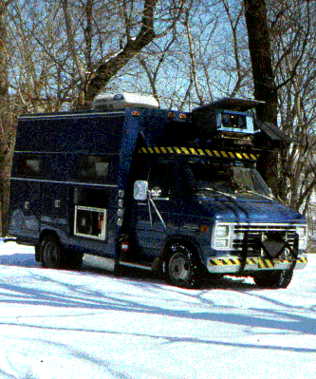
Autonomous Learning Vehicle In a Neural Net (ALVINN)
ALVINN learns to drive an autonomous vehicle at normal speeds on public highways.
ALVINN is a perception systems which learns to control the NAVLAB vehicles by watching a person drive.
Pomerleau et al, 1993
Notes:
the ALVINN system can learn to control an autonomous van in under 5 minutes by watching a person drive. Once trained, individual ALVINN networks can drive in a variety of circumstances, including single-lane paved and unpaved roads, and multi-lane lined and unlined roads, at speeds of up to 55 miles per hour. The techniques also are shown to generalize to the task of controlling the precise foot placement of a walking robot.
Using the results of our research, we have demonstrated systems capable of autonomously driving the Navlab vehicle for long distances at speeds of up to 90 mph. One such vision system, called RALPH (Rapidly Adapting Lateral Position Handler) steered the Navlab for 98.2% of a trip from Washington, DC to San Diego, CA, a distance of over 2800 miles. When augmented with a millimeter wave radar for sensing obstacles, the system can detect vehicles ahead and automatically change lanes when appropriate.

Slide 9
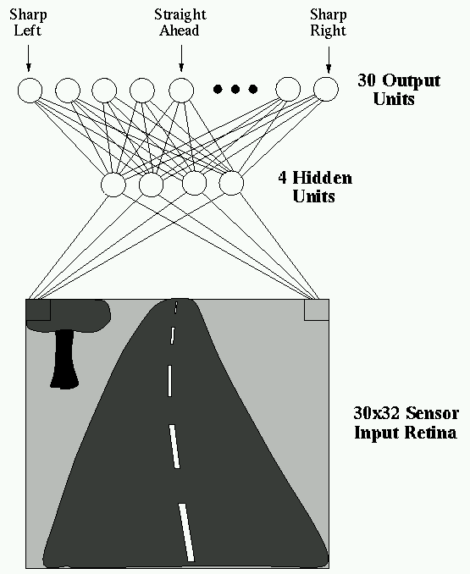
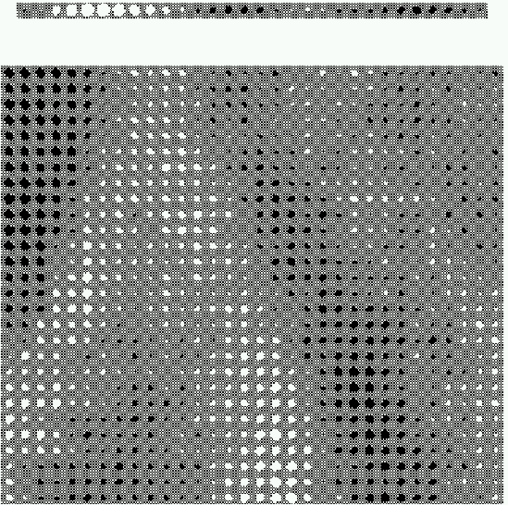
ALVINN drives 70mph on highways
30 x 32 grid of pixel
intensities from camera
Each output unit correspond to a particular steering direction.
The most highly activated one gives the direction to steer.
Notes:
ALVINN is a perception system which learns to control the NAVLAB vehicles by watching a person drive. ALVINN's architecture consists of a single hidden layer back-propagation network. The input layer of the network is a 30x32 unit two dimensional "retina" which receives input from the vehicles video camera. Each input unit is fully connected to a layer of five hidden units which are in turn fully connected to a layer of 30 output units. The output layer is a linear representation of the direction the vehicle should travel in order to keep the vehicle on the road.

Slide 10
What kinds of problems are suitable for neural networks?
Have sufficient training data
Long training times are acceptable
Not necessary for humans to understand learned target function or hypothesis
→ neural networks are magic black boxes

Slide 11
Tasks
Function approximation, or regression analysis, including time series prediction and modeling.
Classification, including pattern and sequence recognition, novelty detection and sequential decision making.
Data processing, including filtering, clustering, blind signal separation and compression.

Slide 12
Example of Application Areas
Application areas include:
System identification and control (vehicle control, process control),
Game-playing and decision making (backgammon, chess, racing),
Pattern recognition (radar systems, face identification, object recognition, etc.)
Sequence recognition (gesture, speech, handwritten text recognition),
Medical diagnosis
Financial applications
Data mining (or knowledge discovery in databases, "KDD"),
Visualization
E-mail spam filtering.

Slide 13
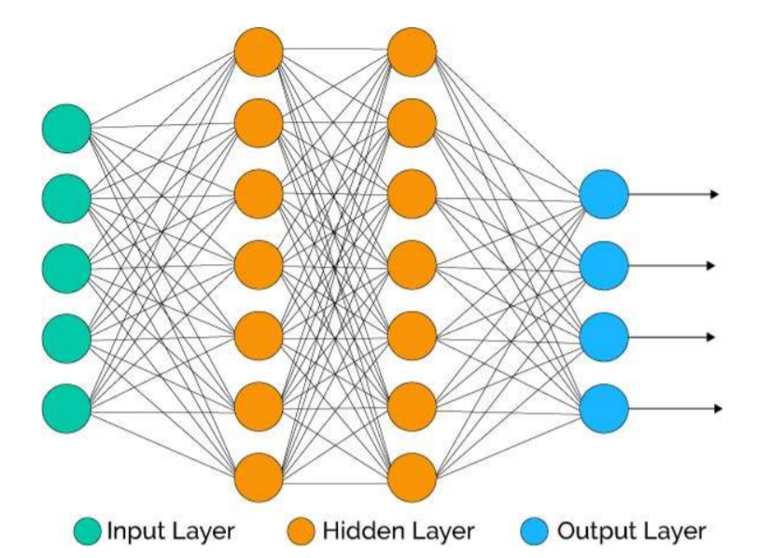
Architecture of Neural Network
A typical neural network contains a large number of artificial neurons called units arranged in a series of layers.

Slide 14
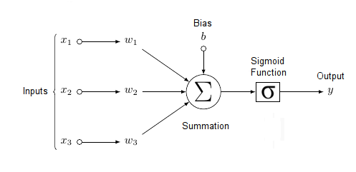
Elements of Neural Networks
1. No Computation on Input layer Neurons
2. Two process on every computational Neuron.
Weighted Sum
Activation Function
Notes:
Each neuron within the network is usually a simple processing unit which takes one or more inputs and produces an output. At each neuron, every input has an associated weight which modifies the strength of each input. The neuron simply adds together all the inputs and calculates an output to be passed on.

Slide 15
The Single Neuron Structure
Bias
b
x₁
w₁
Activation
function
Local
Field
v
Output
y
Input
signal
x₂
w₂
Summing
function
x_{m}
w_{m}
Synaptic
weights
W implies how much Weight or strength to give the incoming input
Think b as offset value making x*w have to reach a certain threshold before having
an effect

Slide 16
Bias as extra input
w₀
x₀ = +1
x₁
w₁
Activation
function
Local
Field
v
Input
signal
Output
y
x₂
w₂
Summing
function
x_{m}
w_{m}
Synaptic
weights
Bias is an external parameter of the neuron. Can be modeled by adding an extra input. We can think it offset value making x*w have to reach a certain threshold before having
an effect

Slide 17
What are Activation Functions?
Activation function helps decide if we need to fire a neuron or not . If we need to fire a neuron then what will be the strength of the signal.
Activation function is the mechanism by which neurons process and pass the information through the neural network
Activation Functions introduce non-linear properties to Neural Network.
There are 2 types of activation functions –
1. Linear Activation Functions
2. Non Linear Activation Functions

Slide 18
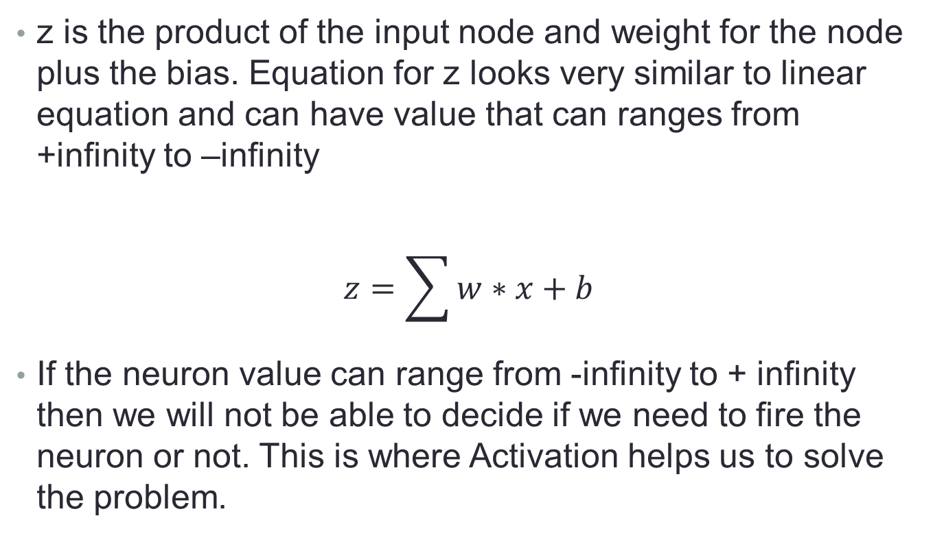
Why do we need an Activation function in Neural network?
z is the product of the input node and weight for the node plus the bias. Equation for z looks very similar to linear equation and can have value that can ranges from +infinity to –infinity
$$z=\sum{w∗x+b}$$
If the neuron value can range from -infinity to + infinity then we will not be able to decide if we need to fire the neuron or not. This is where Activation helps us to solve the problem.

Slide 19
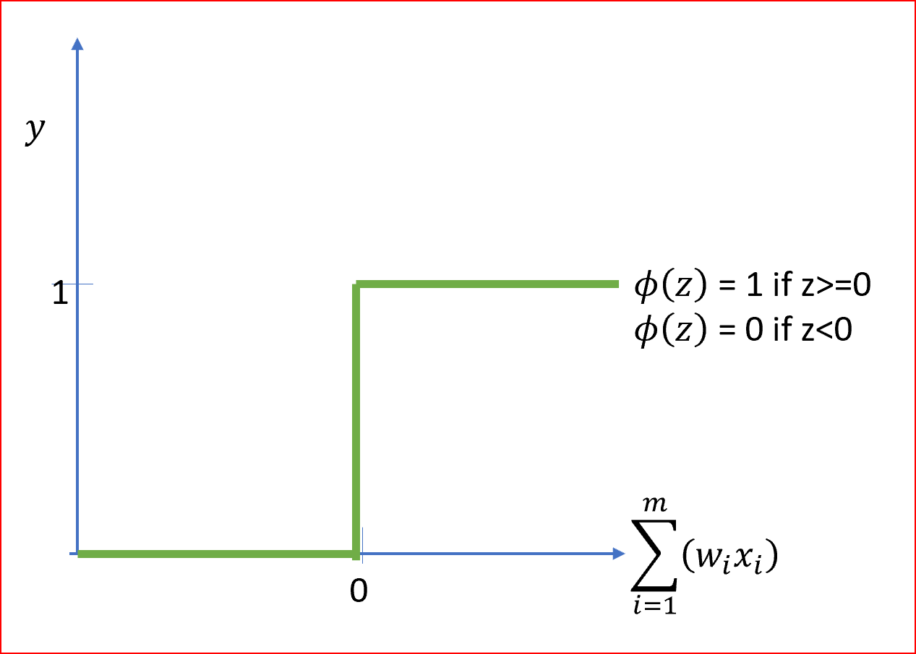
Step Function
The most simple neural network rely on basic step function that outputs 0 or 1.
This sort of function could be useful for classification ( 0 or 1 class)

Slide 20
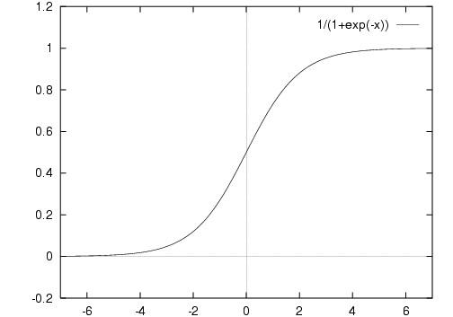
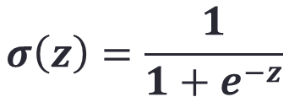
Sigmoid Function
$$σ\left(z\right)=\frac{1}{1+e^{−z}}$$
The function is differentiable. That means, we can find the slope of the sigmoid curve at any two points.
The function is monotonic but function’s derivative is not.
The logistic sigmoid function can cause a neural network to get stuck at the training time.
The softmax function is a more generalized logistic activation function which is used for multiclass classification.

Slide 21
Issues with the logistic activation function
1. Saturation problem
A neuron is said to be saturated if it reaches to its peak value either maximum or minimum.
Saturation when f(x) = 0 or 1 then f’(x) = f(x)(1- f(x)) = 0
In case of back propagation if 1 then its derivative will be 0. So there is no any update in weight, this problem is known as vanishing gradient problem. The gradient of weight vanishes or goes down to zero.
2. Not a zero-centered function
A function having an equal mass on both the sides of zero line (x-axis) is known as a zero-centered function..
During update rule, weights are only allowed to move in certain directions, not in all the possible directions. It makes the optimization harder.

Slide 22
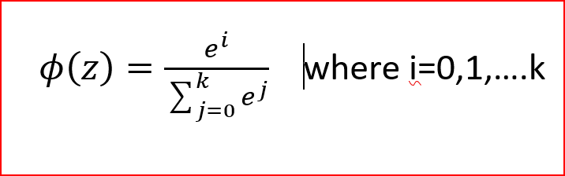
Softmax function
Sigmoid activation function is used for two class or binary class classification whereas softmax is used for multi class classification and is a generalization of the sigmoid function.
In softmax, we get the probabilities of each of the class whose sum should be equal to 1. When the probability of one class increase then the probability of other classes decreases, so the class with highest probability is the output class.

Slide 23
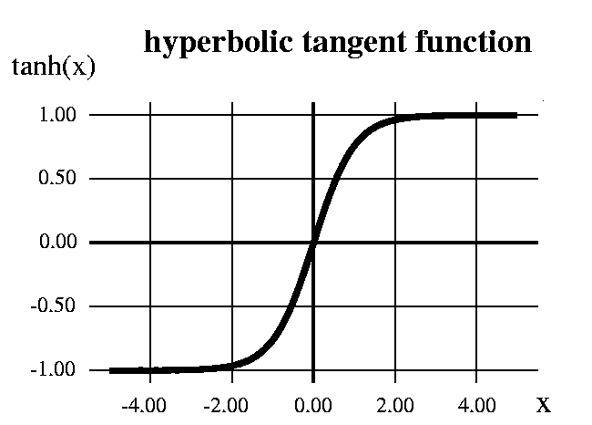
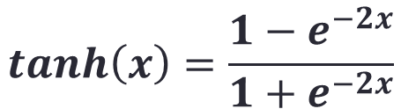
Hyperbolic Tangent function
The function is differentiable.
The function is monotonic while its derivative is not.
The tanh function is mainly used classification between two classes.
output is zero centered because its range in between -1 to 1 i.e -1 < output < 1 . Hence optimization is easier in this method hence in practice it is always preferred over Sigmoid function .
$$\tanh\left(x\right)=\frac{{1−e}^{−2x}}{{1+e}^{−2x}}$$

Slide 24
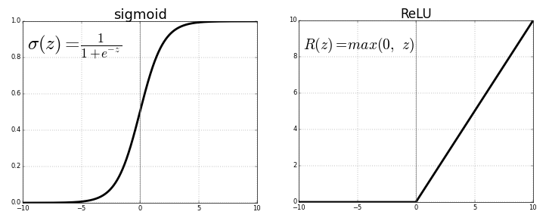

ReLu- Rectified Linear units
The function and its derivative both are monotonic.
It should only be used within Hidden layers of a Neural Network Model.
Hence for output layers we should use a Softmax function for a Classification problem to compute the probabilities for the classes , and for a regression problem it should simply use a linear function.
$$f\left(x\right)=max⁡(x,0)$$

Slide 25
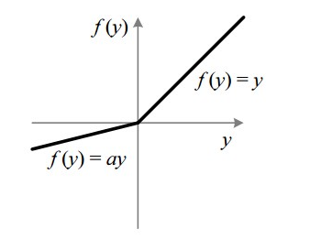

Leaky ReLu
The problem with ReLu is that some gradients can be fragile during training and can die. It can cause a weight update which will makes it never activate on any data point again. Simply saying that ReLu could result in Dead Neurons.
To fix the problem of dying neurons another modification was introduced called Leaky ReLu. It introduces a small slope to keep the updates alive.
$$f\left(x\right)=\left\{\begin{matrix}x if x<0 \\ 0.01x otherwise\end{matrix}\right\}$$

Slide 26
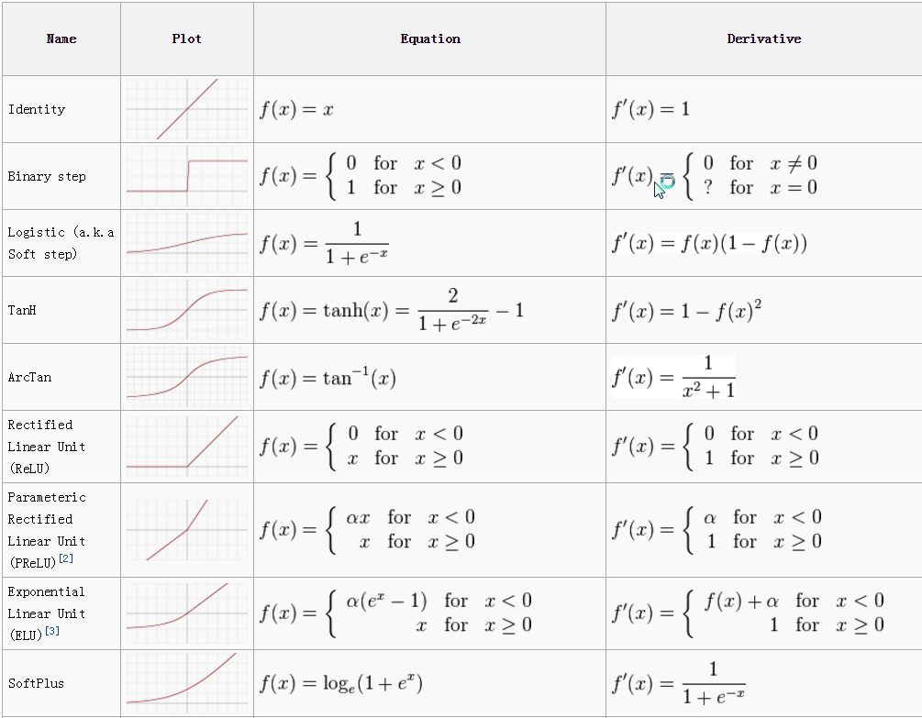

Slide 27
Neural Network Architecture
Three basic different classes of network architectures
Single-layer feed-forward Neural Networks
Multi-layer feed-forward Neural Networks
Recurrent Neural Networks
The architecture of a neural network is linked with the learning algorithm used to train

Slide 28
Single Layer Feed-forward
Neural Network having two input units and one output units with no hidden layers. These are also known as ‘single layer perceptrons.
Input layer
of
source nodes
Output layer
of
neurons

Slide 29
Perceptron
The perceptron is a simple algorithm which, given an input vector x of m values (x1, x2, ..., xn) often called input features or simply features, outputs either 1 (yes) or 0 (no). Mathematically, we define a function:
f(x)=wx+b :1 if f(x)>0 else 0
Here, w is a vector of weights, wx is the dot product , and b is a bias
If x lies above the straight line, then the answer is positive, otherwise it is negative. Very simple algorithm! The perception cannot express a maybe answer. It can answer yes (1) or no (0)

Slide 30
Multi Layer Feed-forward
3-4-2 Network
Input
layer
Output
layer
Hidden Layer
These networks use one or more than one hidden layer of neurons, unlike single layer perceptron. These are also known as deep feedforward neural networks.

Slide 31
Recurrent Network
Recurrent Network with hidden neuron(s): unit delay operator z⁻¹ implies dynamic system
z⁻¹
z⁻¹
z⁻¹
Type of neural network in which hidden layer neurons has self-connections. Recurrent neural networks possess memory. At any instance, hidden layer neuron receives activation from the lower layer as well as it previous activation value.

Slide 32
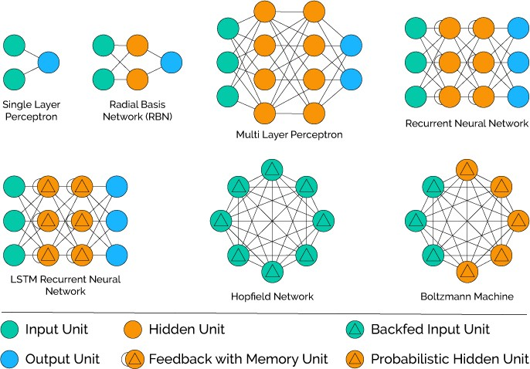
Neural Network Types

Slide 33
Neural Network for Machine Learning
Multilayer Perceptron (supervised classification)
Back Propagation Network (supervised classification)
Hopfield Network (for pattern association)
Deep Neural Networks (unsupervised clustering)

Slide 34
Neural Network for Deep Learning
Recurrent neural network
Multi-layer perceptrons (MLP)
Convolutional neural networks
Recursive neural networks
Deep belief networks
Convolutional deep belief networks
Self-Organizing Maps
Deep Boltzmann machines
Stacked de-noising auto-encoders

